Slide 1
EXTREME ENVIRONMENTS (HIGH ALTITUDE)
GROUP 26

Slide 2
OUTLINE
INTRODUCTION TO HIGH ALTITUDE
EXAMPLES OF AREAS WITH HIGH ALTITUDES
FEATURES OF AREAS WITH HIGH ALTITUDES
ORGANSISMS WHICH INHABIT THESE AREAS

Slide 3
INTRODUCTION
High altitude areas refer to regions that are located at significant heights above sea level.
It refers to areas above approximately 2,500 meters (8,200 feet) or higher.

Slide 4
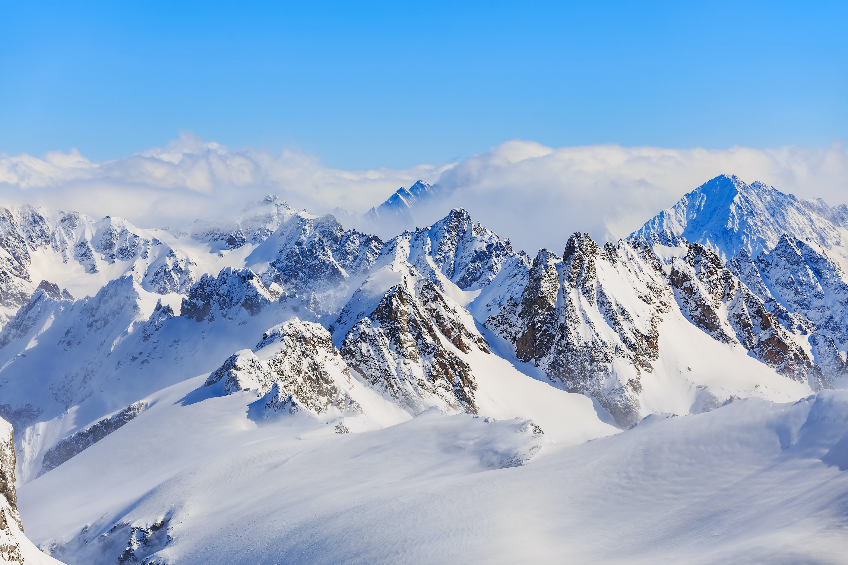
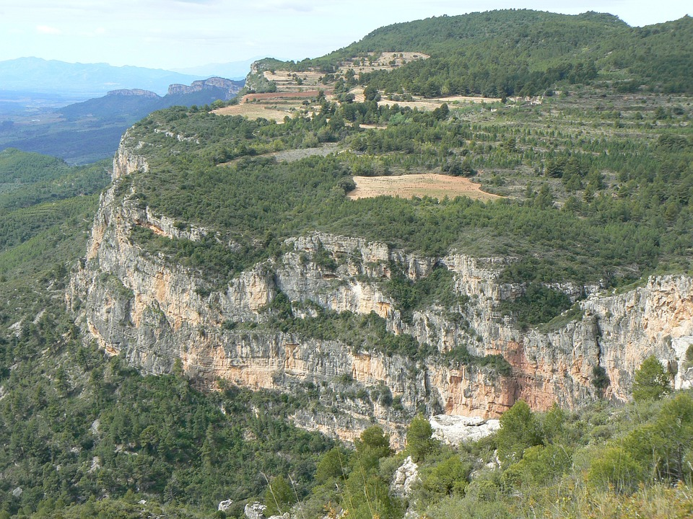
EXAMPLES OF HIGH ALTITUDE AREAS
Mountain ranges
Plateaus

Slide 5
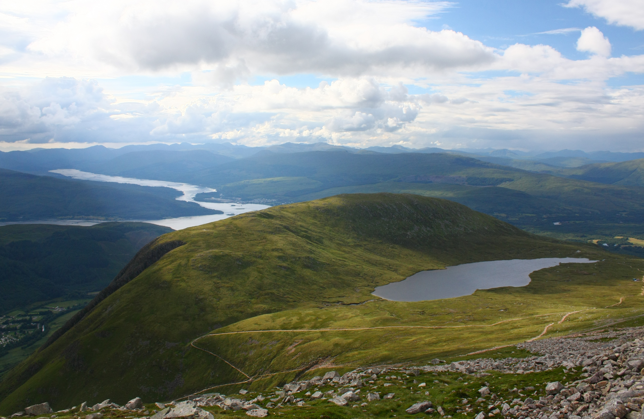
Highlands

Slide 6
FEATURES OF HIGH ALTITUDE AREAS
Low atmospheric pressure
Low oxygen levels
Cold temperatures
Intense UV radiation

Slide 7
ADAPTATIONS OF ORGANISMS IN HIGH ALTIUDE AREAS
Increased Red Blood Cell production
Cold tolerance –thickened fur and feathers for insulation
Elevated breathing rate
Specialized respiratory systems
Small body size

Slide 8
EXAMPLES OF ORGANISMS
PLANTS
Mosses
Lichens
Perennial grasses
ANIMALS
Tibetan gazelles
Ilamas
Yaks
Snow leopard

Slide 9
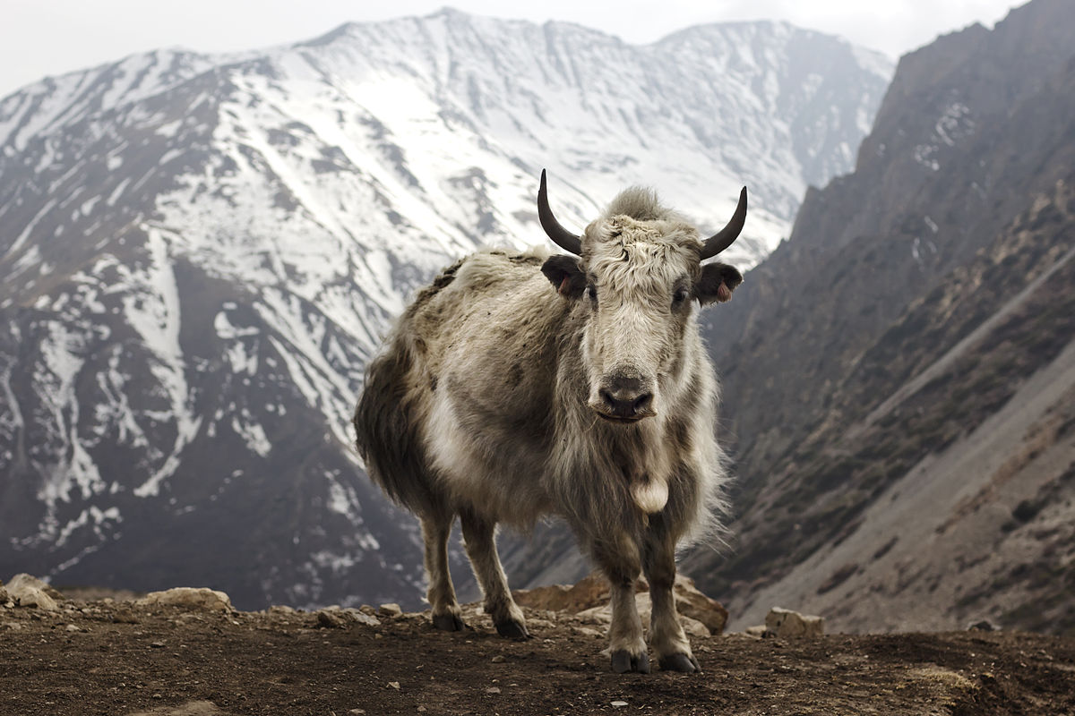
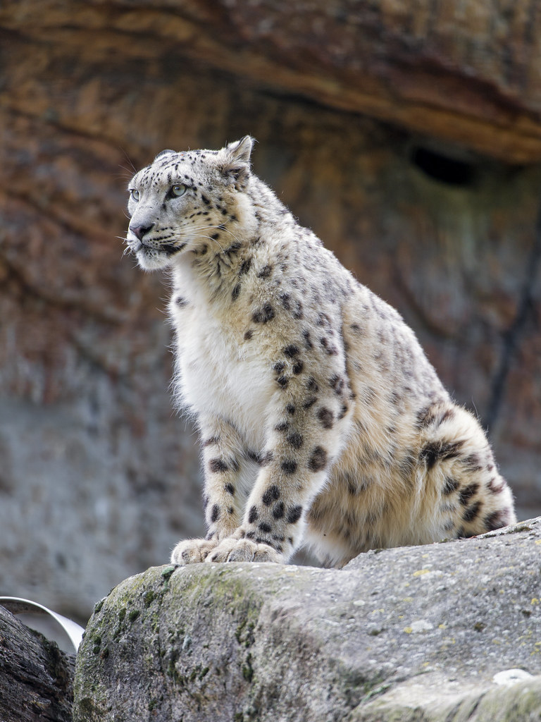
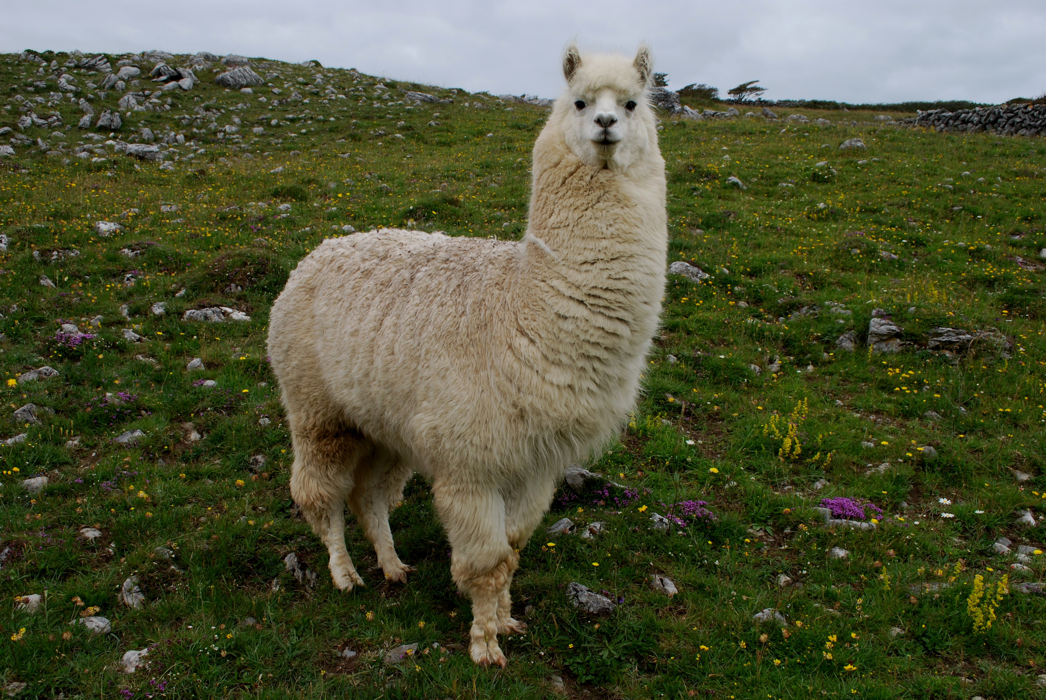

Slide 10
THANK YOU

